Slide 1
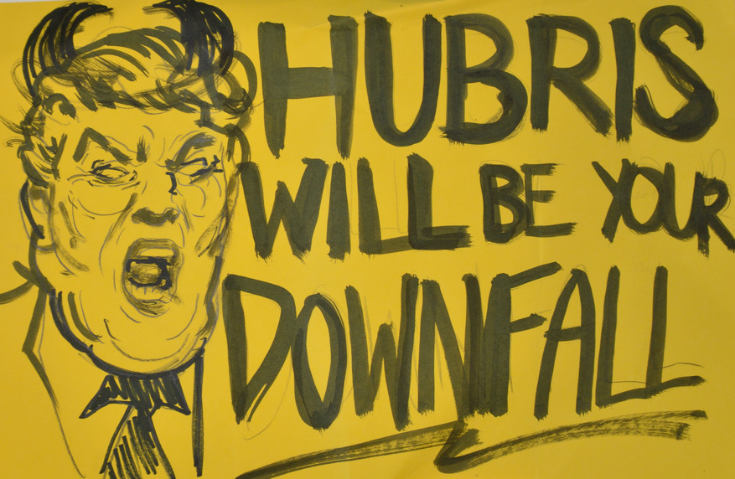
Thanks for Sharing
A Case Study on Crowdsourcing Materials and Metadata for Digital Collections
Sarah Sweeney
Northeastern University Libraries
···
Digital Library Federation Forum
October 16, 2018

Slide 2
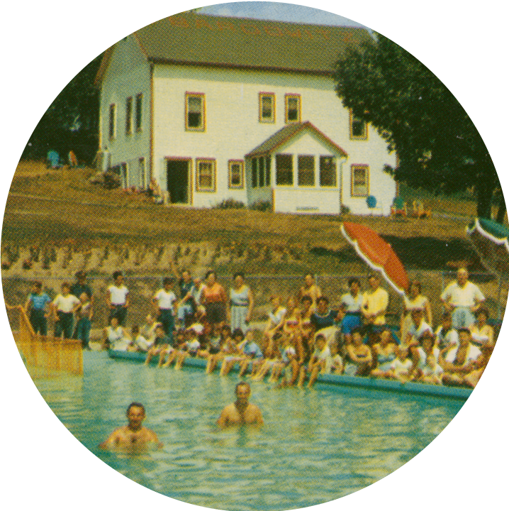
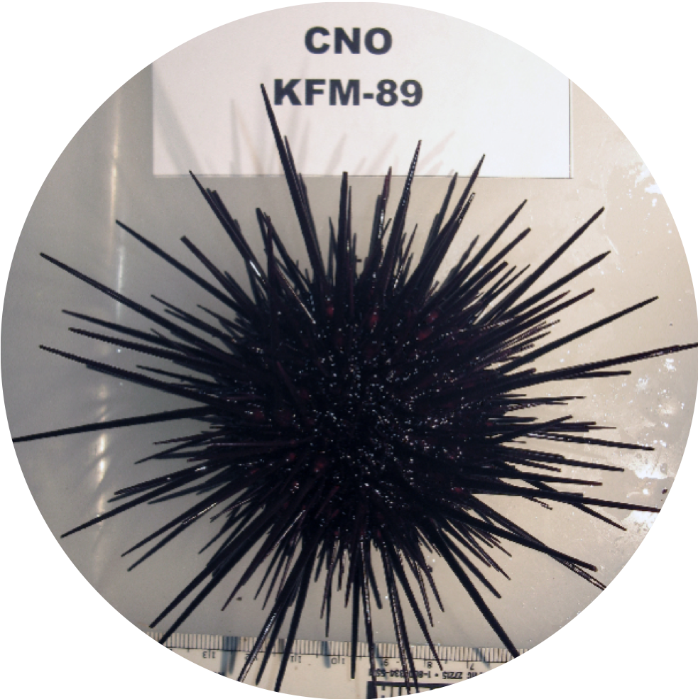
Context
Digital Repository Service (DRS)
https://repository.library.northeastern.edu
1,588
collections
150,000+
digital objects
1,000,000+
downloads

Slide 3

Our Marathon
https://marathon.library.northeastern.edu
Project Team
Elizabeth Dillon
Ryan Cordell
Jim McGrath
Alicia Peaker
Content
22 collections
183 a/v files
630 documents
7,074 images

Slide 4
Our Marathon
Public Submission Elements
Dublin Core
Title
Description
Date
Submission Interface
image not available
Contributor information
Current location
Name
Age
Race
Gender
Other
Submission text
More I might be forgetting...

Slide 5
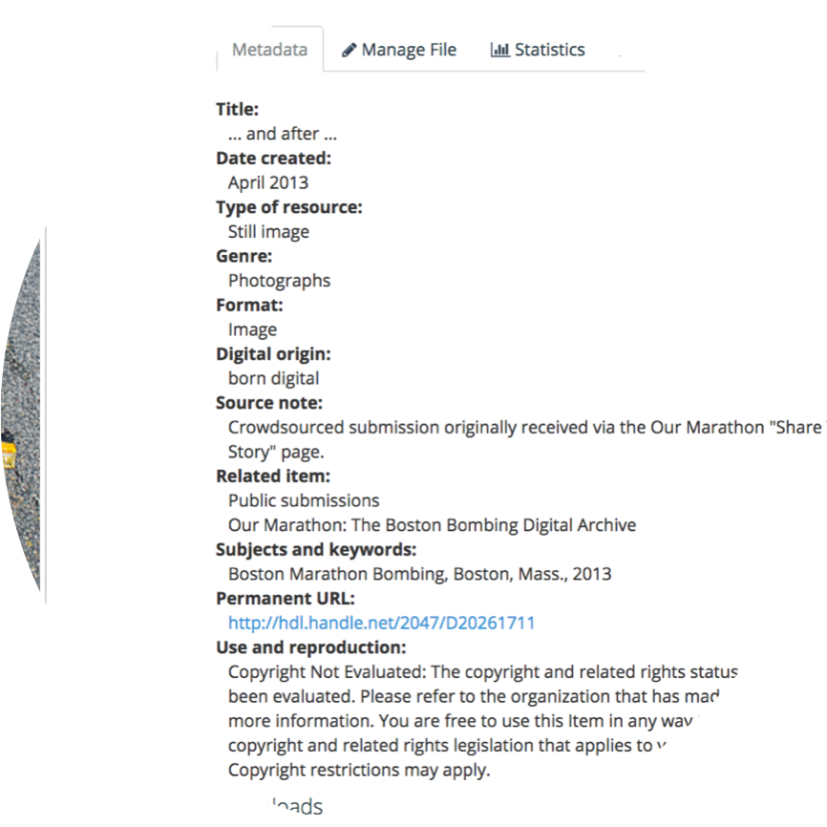
Our Marathon
Kept
(when asked to)
Title
Creator
Description
Contributor information
Submission text
Added
LCSH
Rights Statements
Notes
Only fixed obvious errors

Slide 6
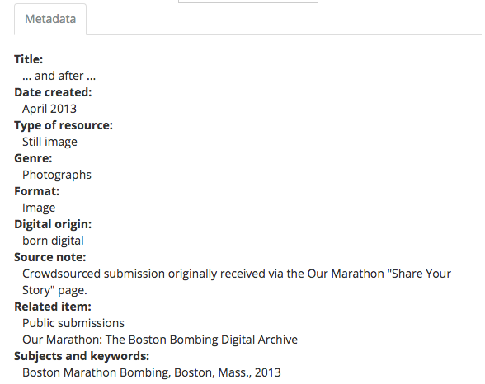
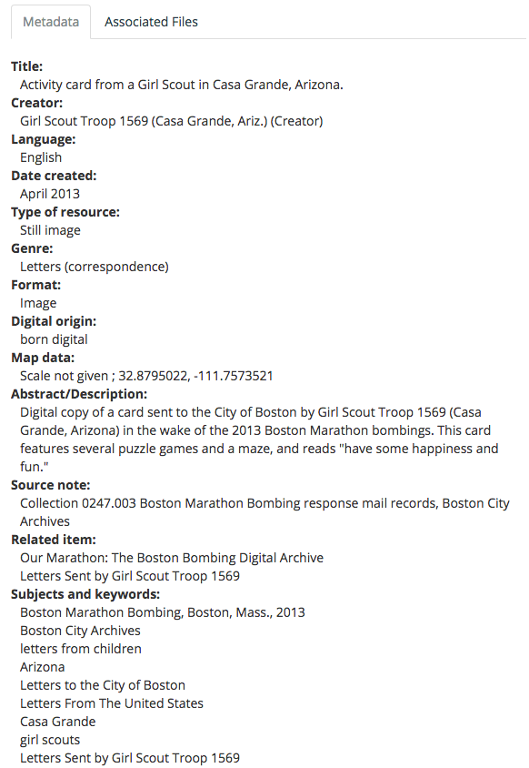
Our Marathon
Public Submission
Partner Submission

Slide 7
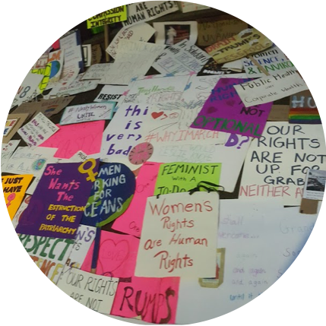
Art of the March
http://artofthemarch.boston
Boston Women's March, January 21, 2017
Project Team
Nathan Felde
Alessandra Renzi
Dietmar Offenhuber
Rescued ~2,000* discarded posters

Slide 8
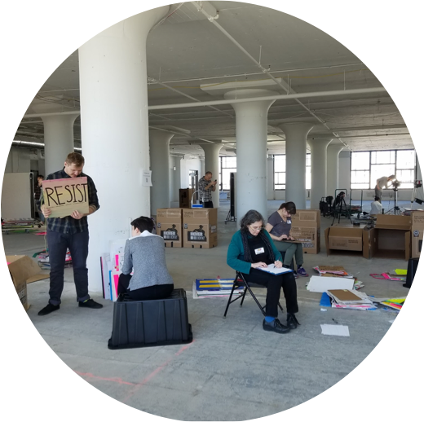
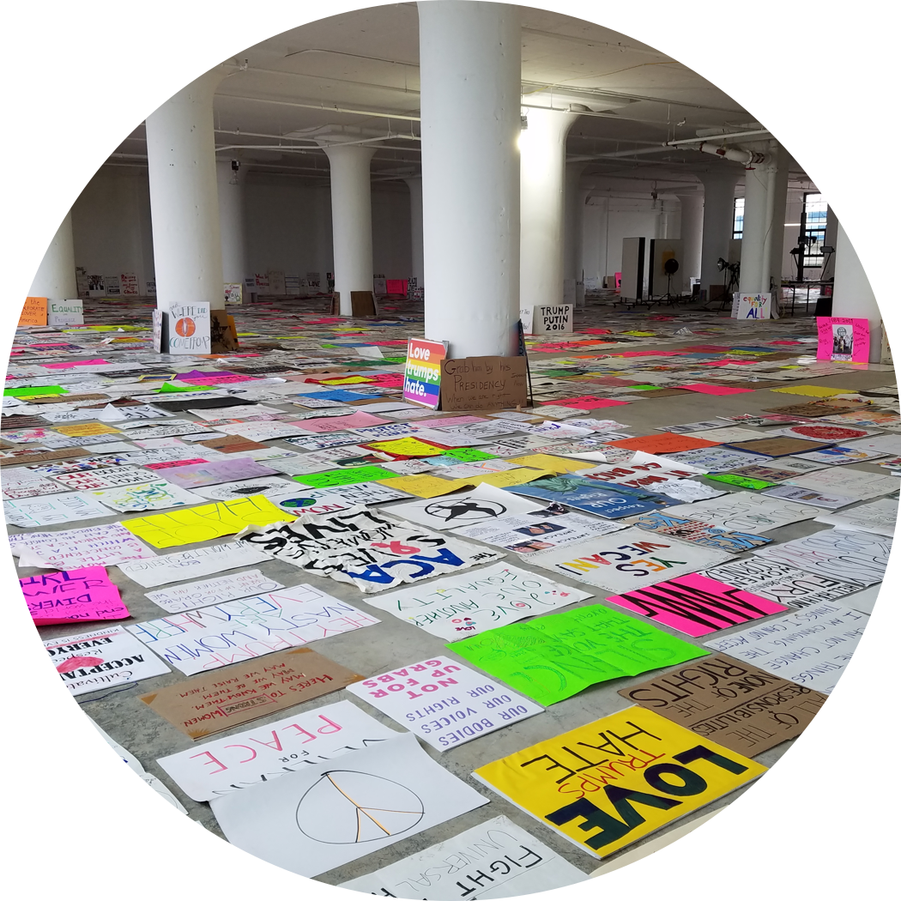
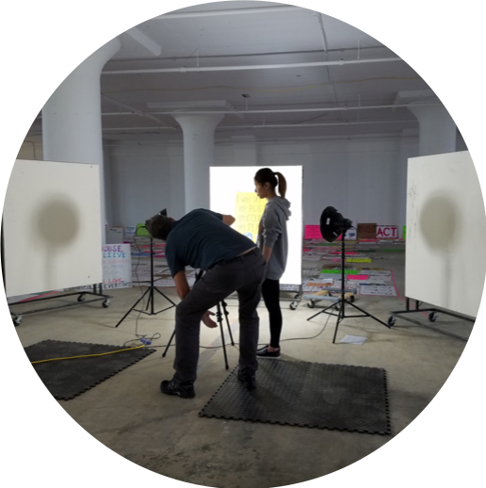
Art of the March
~4,000
rescued posters
3,004
posters cataloged*
5,986
digital images

Slide 9
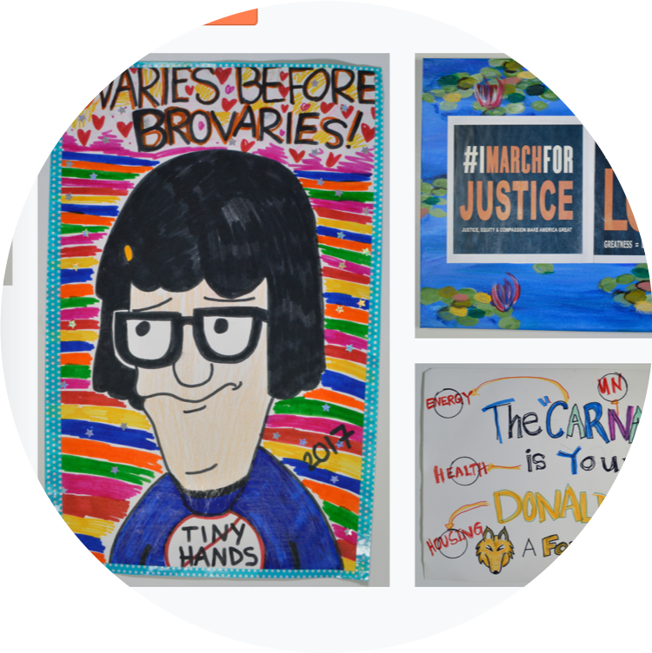
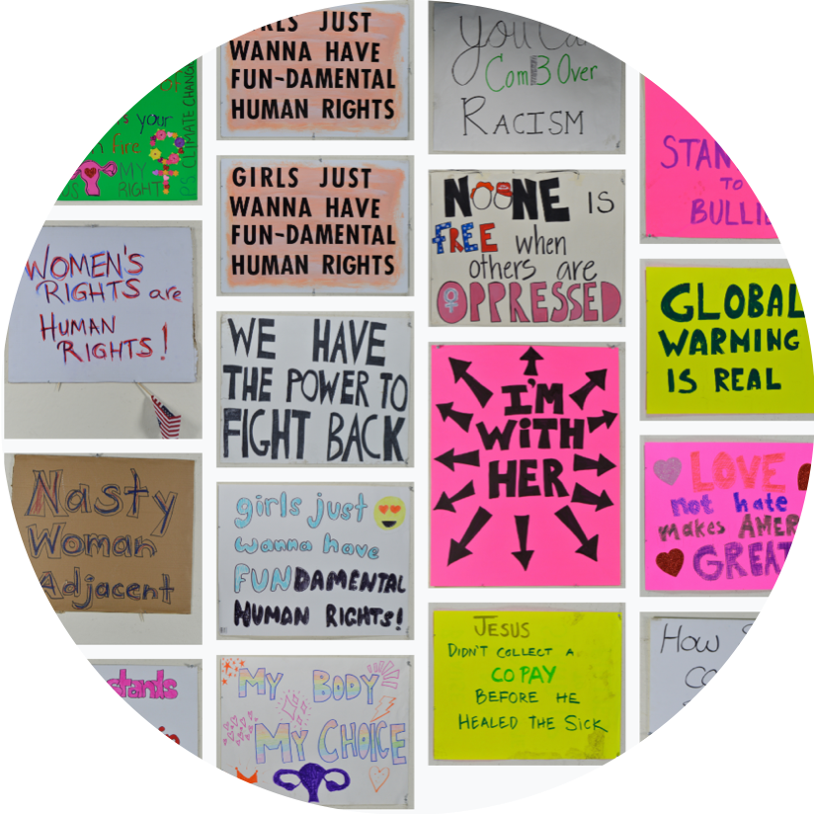
Art of the March
What materials were used to create the poster?
Paper, Cardboard, Poster Board, Fabric,
Acid Free, Other
What is the poster medium?
Ink, Paint, Chalk, Pen, Other
What lettering style is used for the poster text?
Typeface (imitative), Block, Cursive, Decorative, San Serif, Serif, Other

Slide 10
Lessons
Crowdsourcing materials? very difficult!
Crowdsourcing digitization? surprisingly effective!
Crowdsourcing metadata? complicated!

Slide 11
Lessons
How much metadata do we need and how much can we expect to receive?
Is the submitted metadata an artifact or just a starting point?
How will the metadata provenance be documented?
Is the fact that it’s crowdsourced even important?

Slide 12
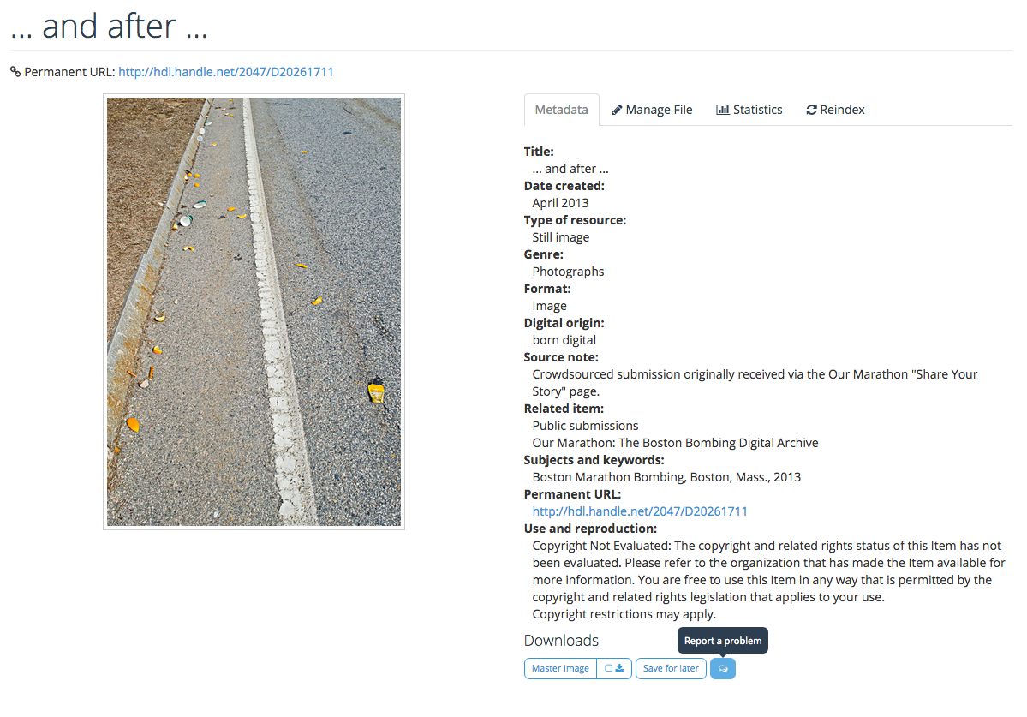
Lessons
“Make a suggestion” instead

Slide 13
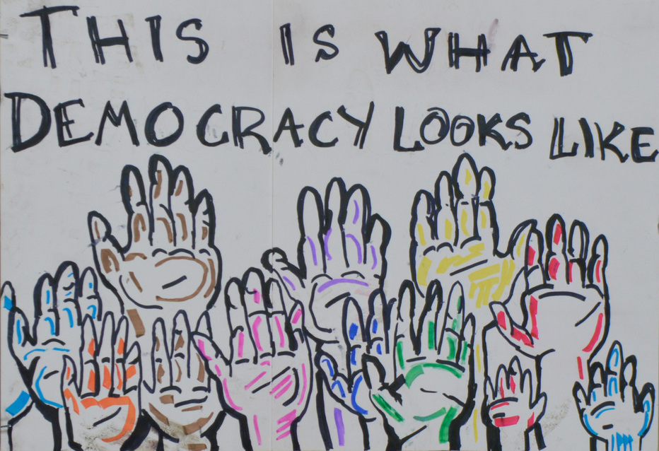

Questions?
Contact:
Sarah Sweeney
sj.sweeney@northeastern.edu
@akaSarahJean

Slide 14
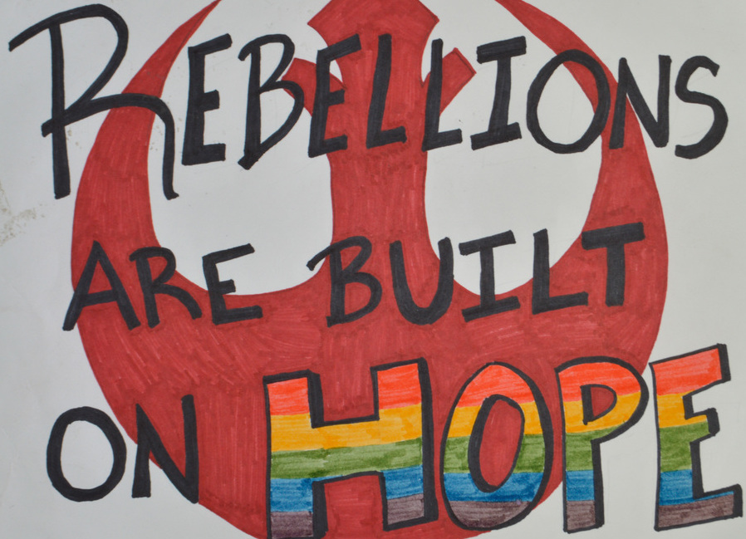
Digital Repository Service (DRS) : https://repository.library.northeastern.edu
Materials used:
Bardow's Cottages : http://hdl.handle.net/2047/D20204197
Strongylocentrotus franciscanus : http://hdl.handle.net/2047/D20264037
Our Marathon: The Boston Bombing Digital Archive : https://marathon.library.northeastern.edu
Our Marathon Public Submissions
http://hdl.handle.net/2047/D20259798 or
https://marathon.library.northeastern.edu/collection/neu:cj82qn382/
Materials used:
.. and after … : http://hdl.handle.net/2047/D20261711
Activity card from a Girl Scout in Casa Grande...: http://hdl.handle.net/2047/D20276407
Art of the March : http://artofthemarch.boston
Materials used:
“Hubris”
“Ovaries / Tina”
“What Democracy Looks Like”
“Rebellions Built on Hope”

